Slide 1
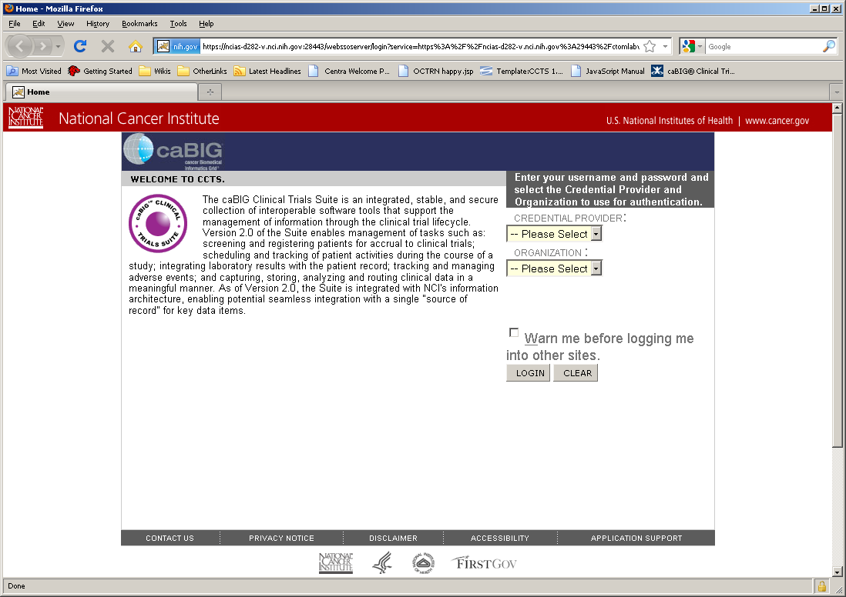
Login Screen – Uses typical CCTS Login

Slide 2
Welcome Screen
Clinical Connector for C3D
Clinical Connector v2.3
October 21, 2010
Configuration Tool
Help
SignOut
Welcome
Welcome to the Clinical Connector Configuration Tool.
Get Started

Slide 3
Primary Working Screen
Clinical Connector for C3D
Clinical Connector v2.3
October 21, 2010
Configuration Tool
Help
SignOut
Files
C3DGrid Service
Clinical Connector
Inbound Controls
DCAPI Credentials
Loadable CDEs
Outbound Controls
Private Studies
Study Security

Slide 4
Primary Working Screen With File Editing
Clinical Connector for C3D
Clinical Connector v2.3
October 21, 2010
Configuration Tool
Help
Sign Out
Files
C3DGrid Service
Clinical Connector
c3dgridservice.properties
Inbound Controls
DCAPI Credentials
Loadable CDEs
c3dds.dburl=@database.url@
c3dds.dbdriverClassName=oracle.jdbc.driver.OracleDriver
c3dds.dbusername=@database.user@
c3dds.dbpassword=@database.password@
csm.application.name=@csm.application.name@
csm.enroll.role=registrar
csm.lab.role=lab_data_user
csm.CDE.role=data_analyst
csm.CDEData.role=data_analyst
enrollPatientManager.saveBirthDate.value=true
enrollPatientManager.saveGender.value=true
enrollPatientManager.saveName.value=true
enrollPatientManager.saveInitials.value=true
enrollPatientManager.saveEnrollmentDate.value=true
enrollPatientService.useCSM=true
loadLabsService.useCSM=true
getStudyCDESService.useCSM=true
getStudyCDEDataService.useCSM=true
isValidStudyService.useCSM=true
Outbound Controls
Private Studies
Study Security
Save
Cancel

Slide 5
Primary Working Screen With Table Editing
Clinical Connector for C3D
Clinical Connector v2.3
October 21, 2010
Configuration Tool
Help
Sign Out
Files
C3DGrid Service
Clinical Connector
Private CDEs [STUDY_PRIVATE_CDE]
Inbound Controls
DCAPI Credentials
Loadable CDEs
STUDY | CDE_ID | CDE_VERSION
00C0079 | 62 | 6.0
ALL | 2001728 | 3.0
ALL | 2003301 | 3.0
Outbound Controls
Private Studies
Study Security
Look Up CDE
Save
Cancel

